Slide 1
One Book One Northwestern Book Group Discussion

Slide 2
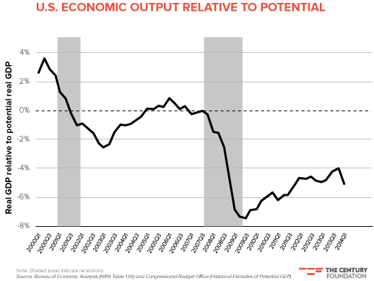
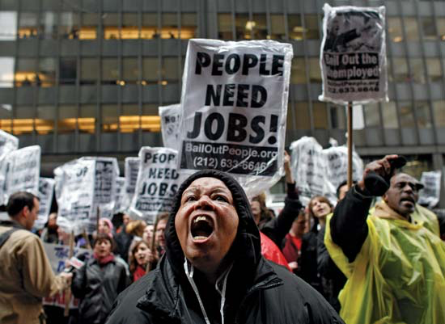
Economics

Slide 3
Economics
How did the 2008 market crash and subsequent economic recession affect you, people you know, your hometown, and/or your state?
Silver states that human characteristics like greed and fear had lasting impacts on the U.S. economic market. How have similar characteristics affected those in your community during the economic recession?
Silver mentions that it is important to acknowledge margin of error in economic forecasting to give accurate and “honest” results. In what other situations (interpersonal relationships, business, medicine, politics, etc.) is it important to acknowledge uncertainty, and why?
  In your experience, when has it been important to acknowledge uncertainty? When has it been more important to seem sure in your prediction? Why?

Slide 4
Economics
Silver argues that it is difficult to predict national GDP because “There's so much data pertaining to factors that might drive GDP growth that it's easy to perceive patterns that aren't real.” He explains that since the national economy is constantly changing, past economic patterns do not necessarily help us to predict future patterns.
  Do you think this is true on a smaller scale, such as individual corporations? Why or why not? What economic information would be important to make predictions regarding a large corporation’s success?
  Do you think this is true on an even smaller scale, such as small “mom and pop” businesses? Why or why not? What economic information would be important to make predictions regarding a small business’ success?

Slide 5
Economics
Have you ever witnessed, either in your community or in the news, a strikingly successful business venture? What do you think contributed to its economic success?
  How could understanding what contributed to the success help predict the success or failure of another business venture?
Have you ever witnessed, either in your community or in the news, a significant business failure? What do you think contributed to its economic failure?
  How could understanding what contributed to the failure help predict the success or failure of another business venture?

Slide 6

Economics: Case Study Activity
Topic Blend: Economics and Politics
The Context: Occupy Wall Street (OWS) is a protest movement that began on September 11, 2011 in New York City. The protestors’ slogan “We Are the 99%” refers to protestors’ perceptions of the income disparity and economic inequality in the U.S.—this statistic was later confirmed by a Congressional Budget Office report released in October 2011. OWS’s goals include a reduction in the influence of corporations on politics, more balanced distribution of income, more and better jobs, bank reform to curtail speculative trading by banks, forgiveness of student loan debt or other relief for indebted students, and alleviation of the foreclosure situation. Since the movement’s inception, protestors have occupied banks, corporate headquarters, board meetings, foreclosed homes, and college and university campuses.
The Debate: Those who support OWS argue that the movement works to fight economic inequality by proposing new economic policy initiatives that could improve overall economic conditions in the U.S. Those who criticize OWS argue that the movement does not have the “depth” and expertise necessary to make accurate economic predictions.

Slide 7
Economics: Case Study Activity
Topic Blend: Economics and Politics
The Questions:
  How could OWS better support the argument that its proposed legislative changes would improve the U.S. economy?
  How could an impartial economic analyst help laypeople (both for and against OWS) understand the workings of economic predictions?
  How could economists and legislators work together to diffuse tensions surrounding OWS and come up with proposals to improve the U.S. economy?

Slide 8

Economics: Case Study Activity
Topic Blend: Economics and the Environment
The Context: A pressing issue in current discussions about economics is that of natural resource depletion and exhaustion. Some researchers have presented concerns that humankind is using renewable and non-renewable natural resources at rates faster than they can be replenished, leading to resource depletion.
The Debate: Some experts argue that humankind will run out of natural energy resources like oil and natural gas due to over-consumption. Others argue that this forecasting is incorrect, as it does not take into account human ingenuity, social change over time, market forces driving up prices (forcing people to find alternative resources), and technology development. They believe that humans will adapt and find new energy resources (or more efficient ways to use existing resources), avoiding natural resource exhaustion.

Slide 9
Economics: Case Study Activity
Topic Blend: Economics and the Environment
The Questions:
  How can market forces influence the occurrence of resource depletion and exhaustion? Could the market help avoid it? If so, how? If not, why not?
    In what ways, if any, could economics experts manipulate market forces to avoid resource depletion and exhaustion?
  Given the importance of using many different data sources in Nate Silver’s book, what do you think Silver would believe regarding predictions about resource depletion and exhaustion?
  Do you think complete resource exhaustion is a real threat? Why or why not?

