Slide 1
One Book One Northwestern Book Group Discussion

Slide 2
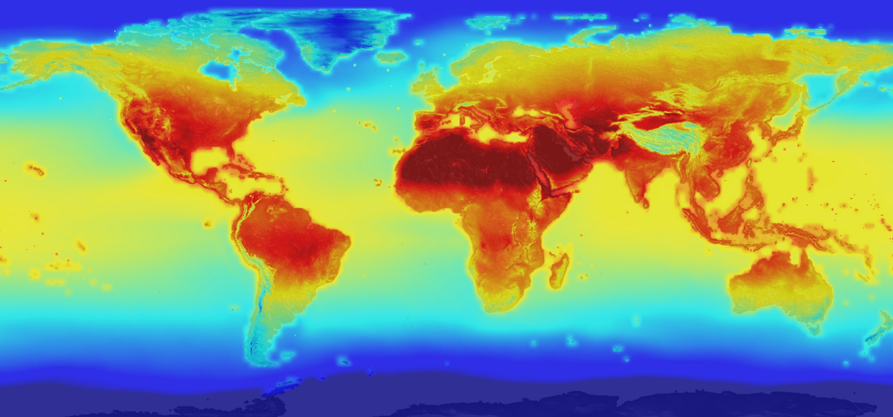
Weather and Climate

Slide 3
Weather and Climate
What are the similarities and differences between weather and climate?
Why is it important to know the similarities and differences, in general?
Why is it important to know the similarities and differences, when discussing prediction science?

Slide 4
Weather and Climate
When discussing the disastrous effects of Hurricane Katrina despite strong forecasting, Silver argues that “…a forecast [does not] do much good if there is no one willing to listen to it.” When do you trust weather forecasts, and when do you not? Why?
How can government and private agencies improve the likelihood of people listening to their forecasts?
Silver argues, “It is forecasting’s original sin to put politics, personal glory, or economic benefit before the truth of the forecast.” In this case he is speaking about inaccurate meteorologists who sacrifice accuracy for the case of good television. When have you noticed someone sacrificing accuracy for “politics, glory, or economic benefit?” Why do you think they did so? What were the effects, short-term and long-term, of that sacrifice?

Slide 5
Weather and Climate
What is the difference between a healthy skepticism towards climate predictions and the type of skepticism that can be dangerous?
According to Silver, there is a huge level of uncertainty regarding climate change prediction. He argues, however, that it is this uncertainty that makes it important to focus on mitigating climate change. Why do you think this is?
  How can experts convince other stakeholders of the importance of mitigating climate change despite the uncertainty in predictions?
What do you think the best way to track past human-created climate change may be?
  How can we ensure that the climate change being tracked is human-created, and not attributable to something else?
What do you think the best way to predict future human-created climate change may be?
  How can we ensure that the climate change being tracked is human-created, and not attributable to something else?

Slide 6
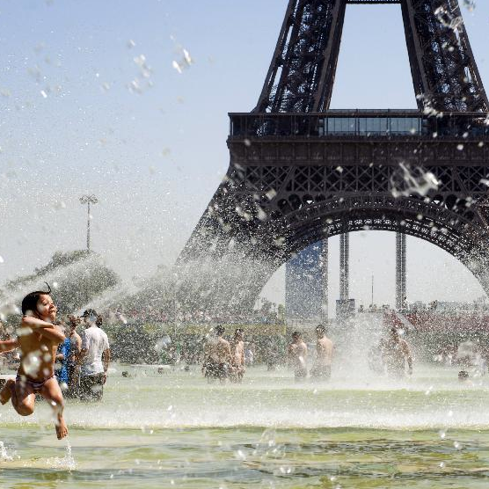
Weather and Climate: Case Study
Topic Blend: Weather, Climate, and Public Health
The Context: In September 2003, a heat wave swept through France, killing almost 15,000 people. The bulk of the victims, many of whom were elderly, died during the height of the heat wave, when temperatures reached up to 104 degrees Fahrenheit. In July 2016, researchers discovered that about 506 of the 735 heat wave-related deaths in Paris were caused by human-created climate change. The researchers used personal computing power donated by the public to conduct simulations using a new, regional climate model.

Slide 7
Weather and Climate: Case Study
Topic Blend: Weather, Climate, and Public Health
The Questions:
  How do you think this discovery, and the new way of attributing deaths to human-created climate change, may change the conversation regarding climate change and its effects on the population?
  What other types of public health-related studies are now possible, due to this new model that can attribute certain outcomes solely to human-created climate change? How would you carry them out?
  What recommendations would you give, based on sociological and climate-related factors, to avoid similar tragedies in the future? Why?

