Slide 1
One Book One Northwestern Book Group Discussion

Slide 2
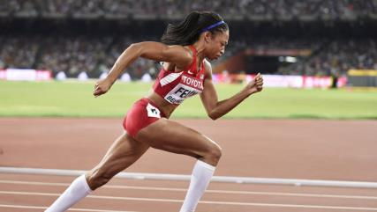
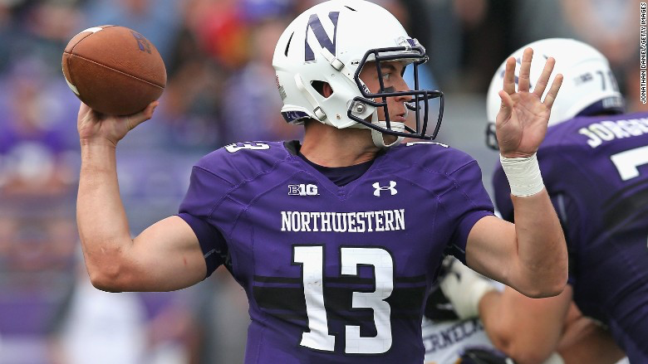
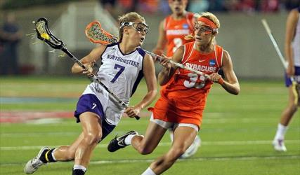
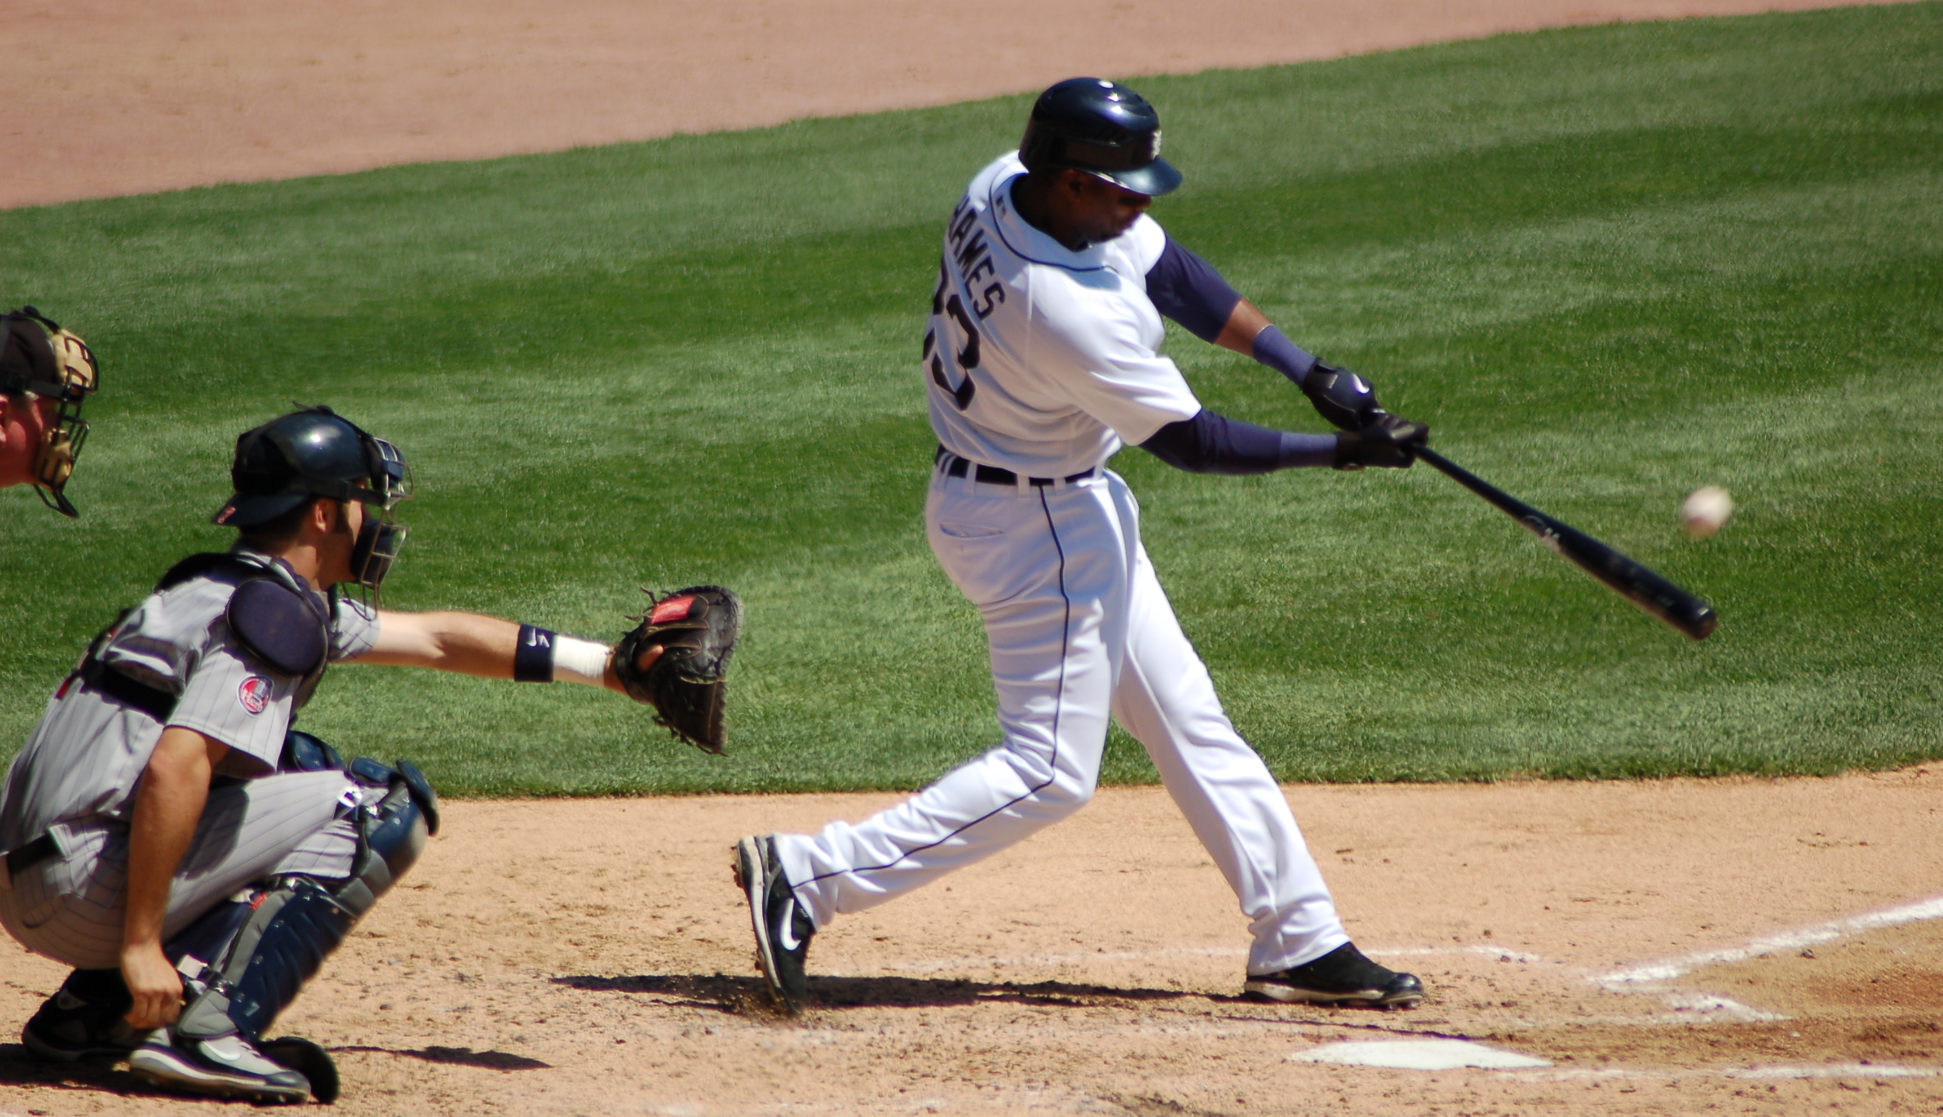
Sports

Slide 3
Sports
Think about a time you (or someone you know) have tried to make a prediction about the outcome of an athletic event or other game.
  What information did you use to make your prediction? Was the information useful?
  Were you correct or incorrect in your prediction? Why do you think that was?
How can human emotion, characteristics, and/or behavior affect a player’s performance? How have you seen this play out in popular sports or other types of games?

Slide 4
Sports
Nate Silver discusses how a simple model predicting a baseball player’s success based on their age was more precise and accurate than a model that took into account more nuanced information. Silver suggests that the second model was less successful because it relied too heavily on existing data.
  Why do you think relying heavily on existing data would lower the accuracy of predictions in sports?
  Do you think the effects of relying heavily on existing data would be different in fields other than athletics (such as economics or disease control)? Why or why not?
  How can forecasters best balance the use of existing data to ensure it does not compromise a prediction’s accuracy?

Slide 5
Sports
Some forecasters have voiced concerns that the very action of making a prediction regarding an athletic event (or other event) can affect the outcome of that event. For instance, a forecast predicting that a certain team will win a championship may affect the behavior and performance of the players.
  Have you witnessed this phenomenon? If so, what happened? How do you think the prediction influenced the outcome of the event?
  In general, do you think athletes should avoid learning about predictions regarding their competitions before the competitions take place? Why or why not?

Slide 6

Sports: Case Study
The Context: The Chicago Cubs, a local Major League Baseball team, garnered attention in 2015-2016 for recruiting a large number of young players. Despite past data suggesting that large numbers of players under the age of 27 lowers a baseball team’s performance, the Cubs has regularly improved its winning percentage despite (or because of) the fact that the team currently has 11 players aged 22 to 26 on its roster. Chad Yoder and Ryan Marx from the Chicago Tribune comment, “In 2015, many said that it was abnormal for a team with so many young players to win so many games, but the Cubs have continued the trend into 2016. They’re really young, and really good.”

Slide 7
Sports: Case Study
The Questions:
  Do you think the Chicago Cubs have improved their performance in recent years because of or despite recruiting so many young players? Why?
  Will the nature of predicting a player’s success relative to age change based on the Chicago Cubs phenomenon? Why or why not?
    Should it change? Why or why not?
  If you were a recruiter for a competing baseball team, such as the St. Louis Cardinals, would you imitate the Cubs’ strategy of recruiting young players to improve team performance? Why or why not?

