Slide 1
One Book One Northwestern Book Group Discussion

Slide 2
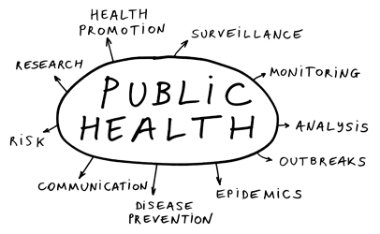

Public Health and Safety

Slide 3
Public Health and Safety
What are some benefits of extrapolation-based prediction in the medical community?
What are the negative consequences of extrapolation-based prediction in the medical community? How can these consequences be prevented?
Nate Silver argues that predictions can be “self-fulfilling,” such as in the case of disease outbreaks. He explains that when disease outbreaks are predicted, measures can be taken to prevent them, which can nullify the prediction.
  What other “self-fulfilling” predictions related to public health can you think of?
  Are there times that making “self-fulfilling” predictions should be avoided? If so, when and why? If not, why not?

Slide 4
Public Health and Safety
At the end of the book, Nate Silver argues, “By knowing more about what we don’t know, we may get a few more predictions right.”
  In the case of potential acts of terrorism, what does the United States not know? Why is that important and helpful to identify?
Silver explains that although governments do their best to prepare for terrorist attacks, they often prepare for the “wrong kinds” of attacks and are not aware of bigger threats.
  How can governments better predict what types of attacks may occur? Would working with other countries be helpful? Why or why not?
  How can governments better prepare for bigger threats? Would working with other countries be helpful? Why or why not?
  How can governments avoid infringing on people’s freedoms when preparing for terrorist attacks? Is it even important that they avoid this?

Slide 5
Public Health and Safety
When working in developing countries, researchers use a variety of data-collection methods to learn more about the country of focus and create predictions and recommendations regarding public health in that location. Community-based research, “a partnership approach that equitably involves community members, organizational representatives, and researchers in all aspects of the research process and in which all partners contribute expertise and share decision making and ownership” (Israel, 1998), tends to be on a relatively smaller scale than researchers working with “big data” about certain populations without individual input from community members about the research and model-making process.
  What are the benefits and drawbacks to each research type when working in developing countries?
  How accurate do you think models deriving from each research type would be? How could you improve the accuracy predictions arising from each research type?
  In what types of research and prediction situations would each research type be most suited?

Slide 6
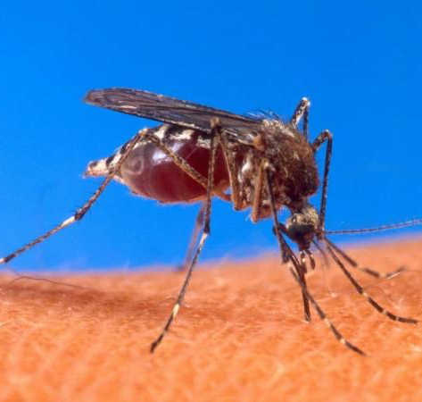
Public Health and Safety: Case Study
The Context: In 2016, many in the public health sector—and, consequently, the general public—became concerned with the spread of the Zika virus. According to Morgan Searles from the Evanston Patch, “Zika virus can spread through mosquito bites, and common symptoms include fever, rash, joint pain and red eyes. Symptoms usually last between several days and a week. However, pregnant women who are infected with the Zika virus have reported poor pregnancy outcomes and giving birth to babies with birth defects, according to the Illinois Department of Public Health.” The first confirmed case of the Zika virus was in Brazil; as a result, the 2016 Summer Olympic Games, held in Rio, were a cause of concern for the virus’s spread across the world. As of August 2016, there were 46 confirmed cases of the Zika virus in Illinois.

Slide 7
Public Health and Safety: Case Study
The Questions:
  What strategies would be the most effective to predict the spread of the Zika virus and its consequences? What types of data should be taken into account?
  What precautions could be taken to prevent the spread of infectious diseases like the Zika virus in different countries?
  How can researchers incorporate special circumstances, like the Olympic Games, when creating models for predicting the spread of infectious diseases?

