Slide 1
One Book One Northwestern Book Group Discussion

Slide 2
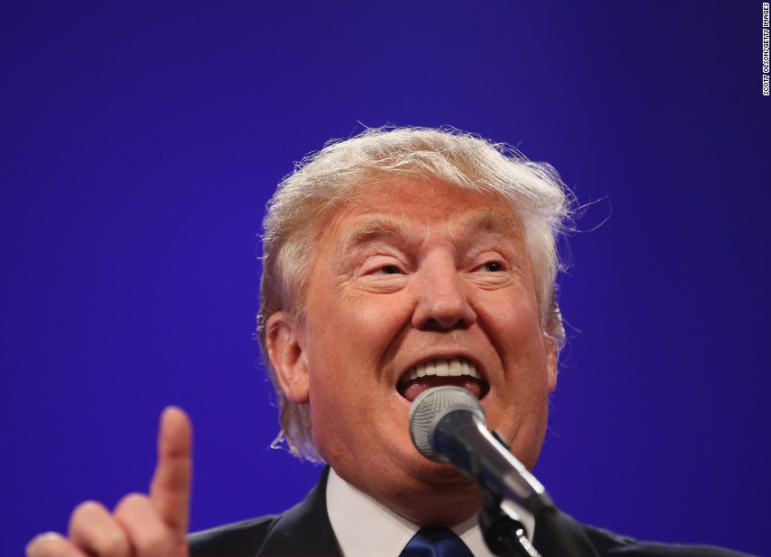
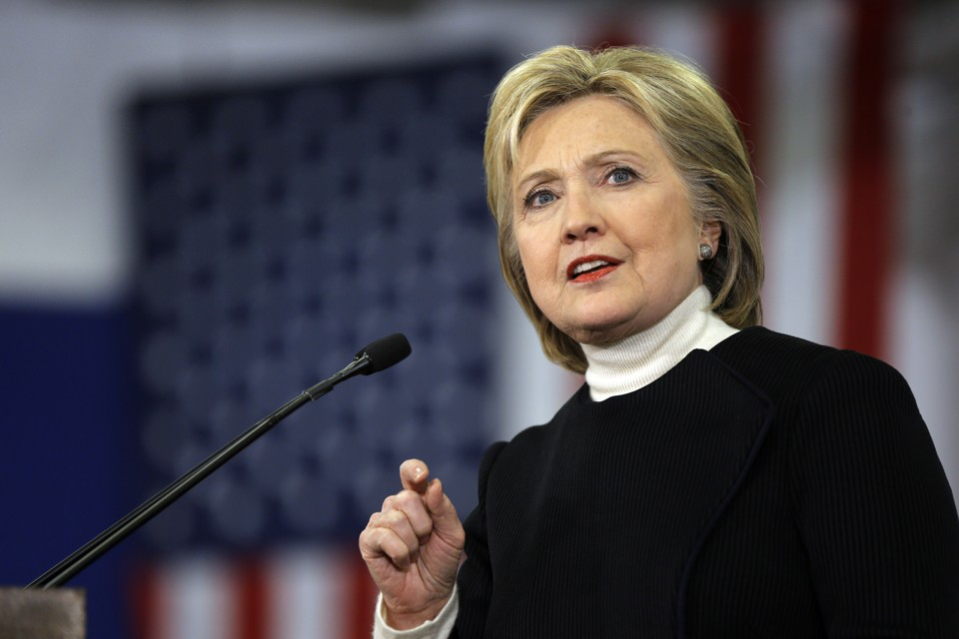
Politics

Slide 3
Politics
How do you think someone’s political affiliation (Republican, Democrat, Green, Libertarian, Independent, etc.) may affect his or her analysis of the likelihood of certain world events? When have you seen this happen in real life?
  E.g. elections, wars, trade deals, environmental policy, etc.
How can someone manage his or her own biases when making political predictions? Use your ideas and Silver’s.
This election cycle has had a series of anomalies, especially regarding the race for and selection of presidential candidates.
  What specific anomalies have you noticed in this election cycle?
  How can political analysts factor in the possibility of anomalies in their predictions, given that there is no model to look back on that incorporates these anomalies?

Slide 4
Politics
In May 2016, Nate Silver published a blog post called “How I Acted Like A Pundit And Screwed Up On Donald Trump.” In the post, he lists reasons for why he incorrectly predicted that Trump would not win the Republican nomination for President, including that he ignored polls in favor of “educated guesses.” Harry Enten, a senior analyst at Nate Silver’s website FiveThirtyEight, describes more of this problem in an interview with This American Life.
  Why do you think Silver and his team ignored polls in this case, when they have relied on them heavily in the past?
  How do you think Silver’s predictions would have turned out differently if he had taken polls into consideration?
  Do you think Silver’s personal biases regarding the presidential candidate influenced his decisions when making his predictions? Why or why not?

Slide 5
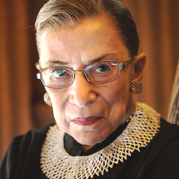
Politics: Case Study
The Context: In July 2016, Supreme Court Justice Ruth Bader Ginsburg was criticized for making public statements about the unfitness of presidential candidate Donald Trump. During an interview with CNN legal analyst Joan Biskupic, Ginsburg stated, “[Trump] is a faker. He has no consistency about him. He says whatever comes into his head at the moment. He really has an ego. ... How has he gotten away with not turning over his tax returns? The press seems to be very gentle with him on that.” She had previously made similar statements to The New York Times, stating, “I can't imagine what this place would be -- I can't imagine what the country would be -- with Donald Trump as our president.” Ginsburg later apologized for her remarks.
The Debate: Supporters of Ginsburg argue that she did not violate any judicial codes of ethics when making her statements about Trump. The judicial code of ethics says that judges are not to endorse or oppose candidates for elected office. These provisions, however, do not apply to Supreme Court justices. Critics of Ginsburg argue that Supreme Court justices have an unfair immunity from the ethics code, and that there needs to be an enforceable code for Supreme Court justices that bars them from making public comments about candidates for public office.

Slide 6
Politics: Case Study
The Questions:
  Does Ginsburg deserve criticism for her statements? Why or why not?
  Should Supreme Court justices be barred from making public comments about candidates for public office? Why or why not?
  In general, is it important that certain public figures remain politically unbiased? Which public figures should remain publically unbiased, and which ones should be allowed to make political, public statements? Why or why not?

Slide 7
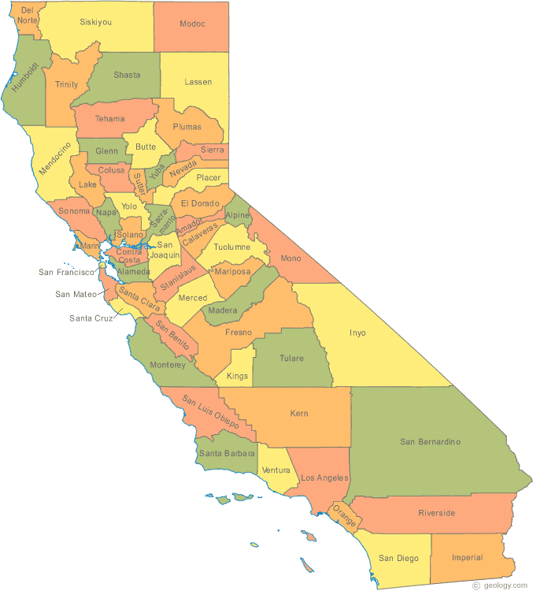
Politics: Case Study
The Context: During the June 2016 California Democratic presidential primary election, the two candidates on the ballot for the presidential candidate were Hillary Clinton and Bernie Sanders. The evening before the election, news outlets reported strong predictions that Hillary Clinton would win the presidential primary. The voter turn-out the next day for the California primary was relatively low, and Hillary Clinton won California and the overall Democratic presidential nomination.
The Debate: Some experts argue that the act of making a prediction can influence people’s behavior and contribute to a certain result; in other words, the act of predicting that Hillary Clinton would win the primary before the California primary caused low voter turn-out among Sanders’ supporters, ensuring that Clinton would win. These experts argue that pundits have an obligation to avoid making predictions when it may influence an outcome. Others argue that pundits do not have this responsibility.

Slide 8
Politics: Case Study
The Questions:
  Do political pundits have the responsibility to avoid making predictions when they may influence an outcome? Why or why not?
  Do you think political pundits purposely make certain predictions in order to achieve the outcome they want? Why or why not?
  Who has the responsibility to remain objective in predictions when those predictions may influence an outcome?

