Slide 1
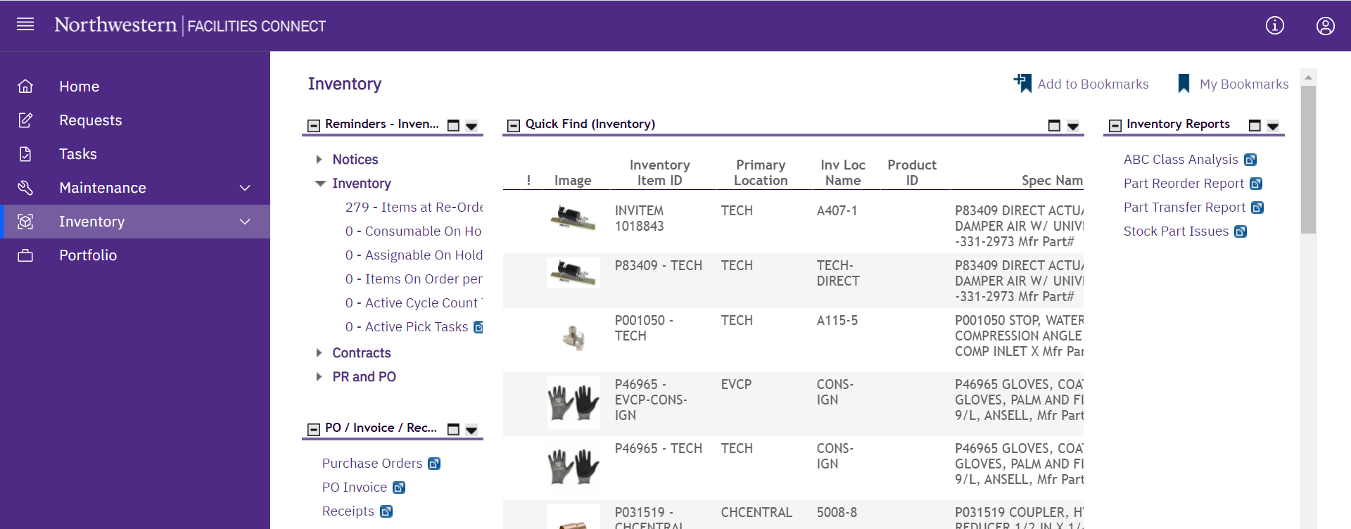
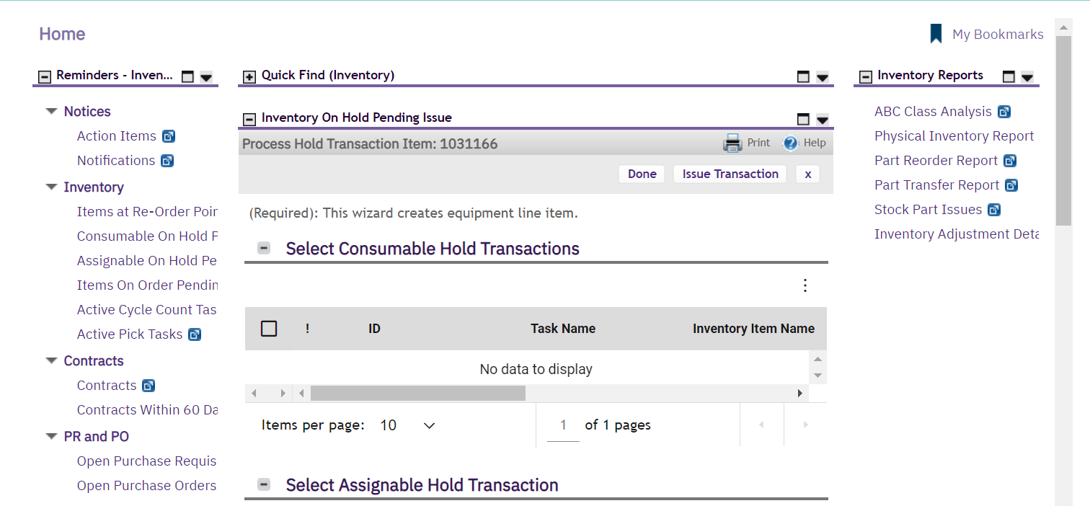

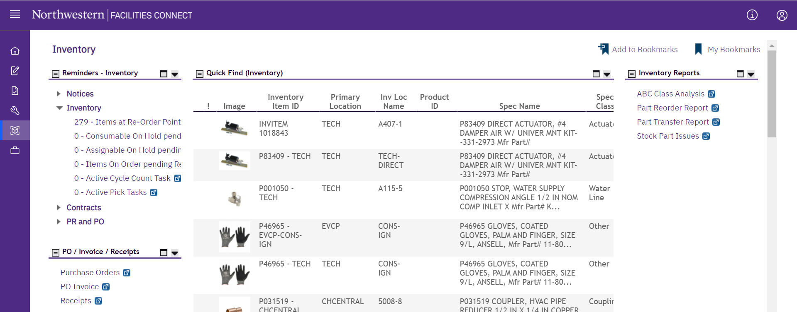

Provides guidance for how to receive inventory for stock parts.
DIRECTIONS:
1
        From the Facilities Connect Home Screen:
        Click on the Inventory screen.
1
1
2
        From the Inventory screen:
        Click on Receipts.
2
2
 TIP & TRICKS
If you want the Receipts screen to open in a new window, click on the blue arrow next to Receipts

Slide 2
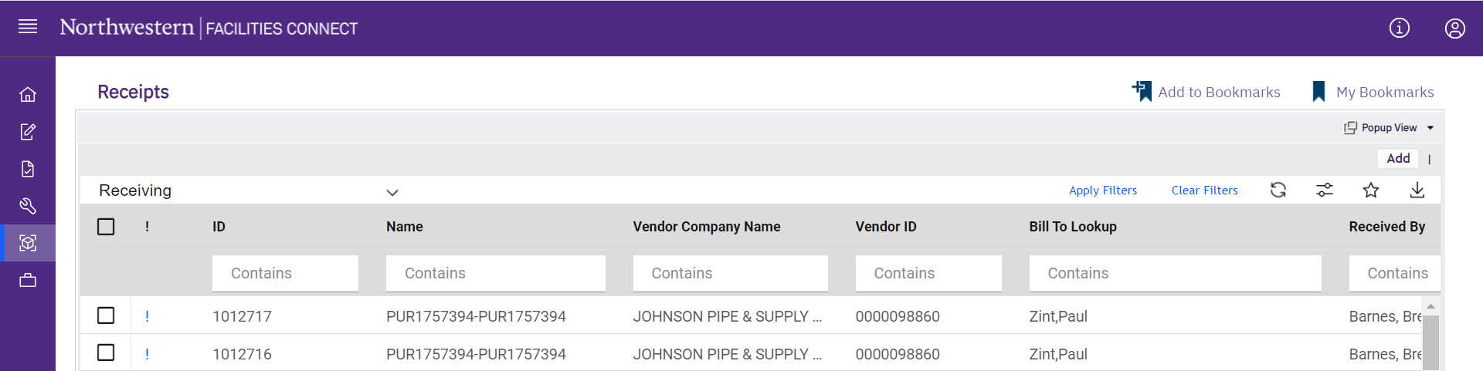

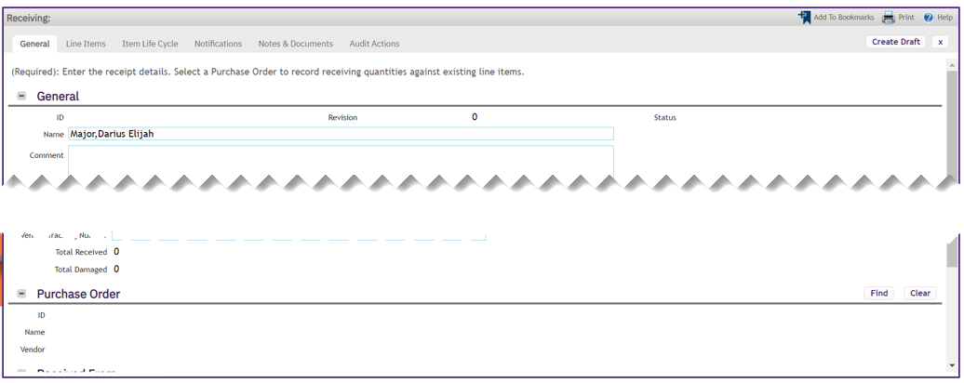


DIRECTIONS:
3
        Upon clicking, the Inventory Receipts window will open:
        Click on Add
3
3
4
        Upon clicking a new Receiving window will open. On the General tab:
        Locate the Purchase Order section.
        Click on Find
4a
4b
4a
4b

Slide 3

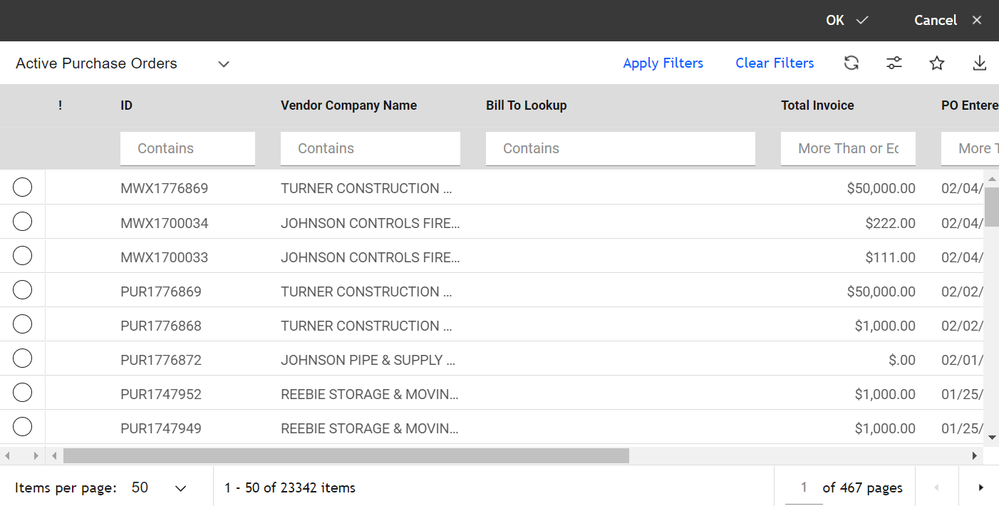


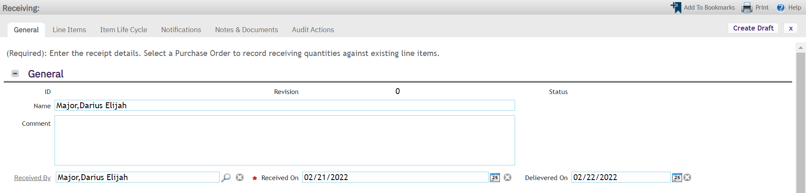
DIRECTIONS:
5
        Upon clicking, the Active Purchase Order window will open:
        Enter the PO# in the ID box and press Enter.
        Click on the radio button next to the purchase order you want to open.
        Click OK. This will close the PO window and add the PO to the receipt.
5a
5b
5c
5c
5a
5b
6
        From the Receiving window:
        Click on the Line Items tab.
6
6

Slide 4
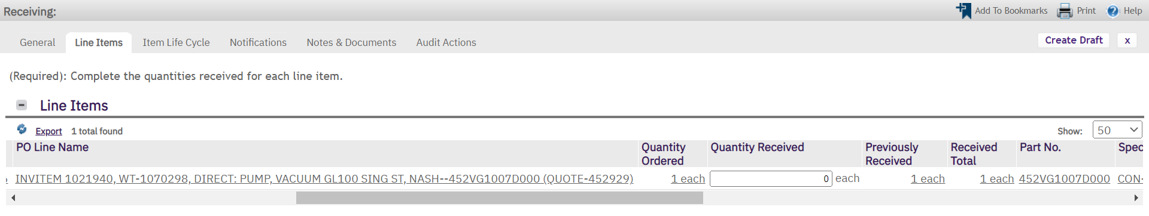

DIRECTIONS:
7
        From the Line Items tab:
        Click on Create Draft.
        Enter the Quantity Received.
        Click on Issue.
 IMPORTANT
Before taking Step 8 – Carefully review that the PO has not already been received. If it has been received, click the X in the upper right-hand corner to exit the window.
7a
7a
7b
7c
7c
7b
 INFORMATION
DO NOT click the check box on the left for Stock Parts. This is for Direct Parts only.
 IMPORTANT
Once you have completed the Facilities Connect process, write the receipt transaction #, data received, and initial on packing slip.

